Slide 1
Machine Learning
Introduction to Machine Learning

Slide 2
Contents
Artificial Intelligence vs Machine Learning vs Deep Learning
Types of Learning
Supervised
Unsupervised
Reinforcement
Does Money make people happy

Slide 3
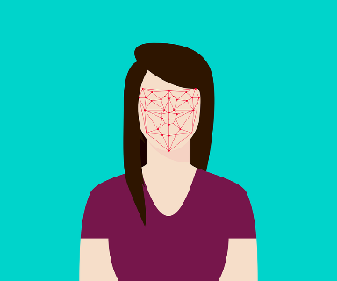
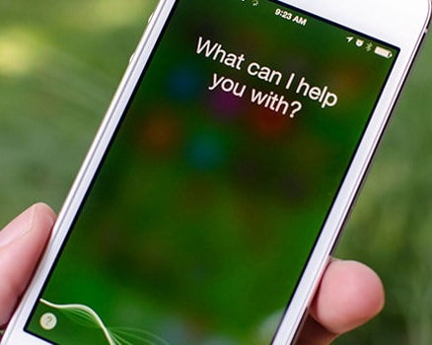

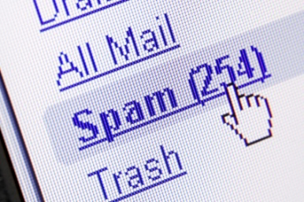
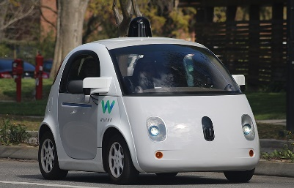
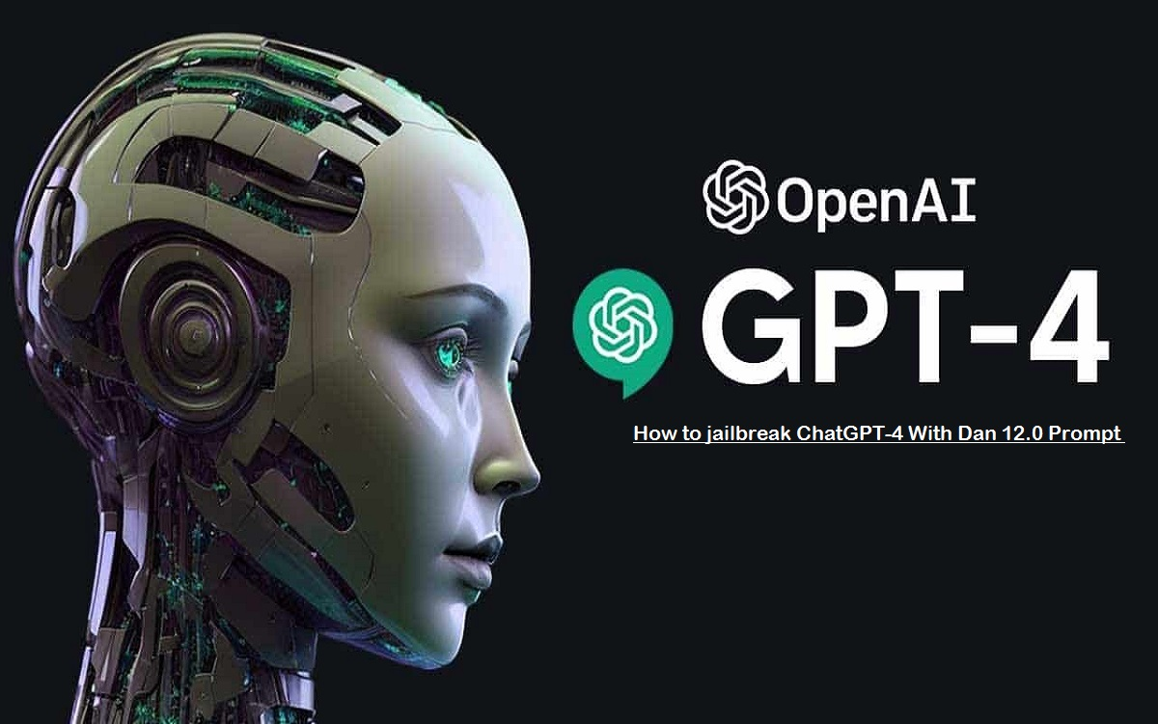

Introduction
Artificial Intelligence/Machine learning does not only mean robots or Sci-Fi movies!
Machine and deep learning applications are everywhere!
Google search engine, amazon recommender systems, Facebook facial recognition (tagging), Siri

Slide 4
Introduction
The pace of progress in artificial intelligence (I’m not referring to narrow AI) is incredibly fast. Unless you have direct exposure to groups like Deepmind, you have no idea how fast—it is growing at a pace close to exponential. The risk of something seriously dangerous happening is in the five-year time frame. 10 years at most.
Elon Musk
ChatGPT is incredibly limited, but good enough at some things to create a misleading impression of greatness. it’s a mistake to be relying on it for anything important right now. it’s a preview of progress; we have lots of work to do on robustness and truthfulness.
Sam Altman, CEO OpenAI. Twitter
Artificial intelligence is one of the most profound things we’re working on as humanity. It is more profound than fire or electricity.
Sundar Pichai CEO Google

Slide 5
Artificial Intelligence
Science that empowers computers to mimic human intelligence
decision making, text processing, and visual perception.
Artificial Intelligence
Machine Learning
Deep Learning

Slide 6
Machine Learning
A subfield of Artificial Intelligence that enables machines to improve at a given task with experience.
All machine learning techniques are classified as Artificial Intelligence but not all Artificial Intelligence could count as Machine Learning.
e.g. some basic Rule-based engines could be classified as AI but they do not learn from experience therefore they do not belong to the machine learning category.
Artificial Intelligence
Machine Learning
Deep Learning

Slide 7
Deep Learning
A specialized field of Machine Learning that relies on training of Deep Artificial Neural Networks (ANNs) using large dataset such as images.
ANNs are information processing models inspired by the human brain.
The human brain consists of billions of neurons that communicate to each other using electrical and chemical signals and enable humans to see, feel, and make decision.
Artificial Intelligence
Machine Learning
Deep Learning

Slide 8
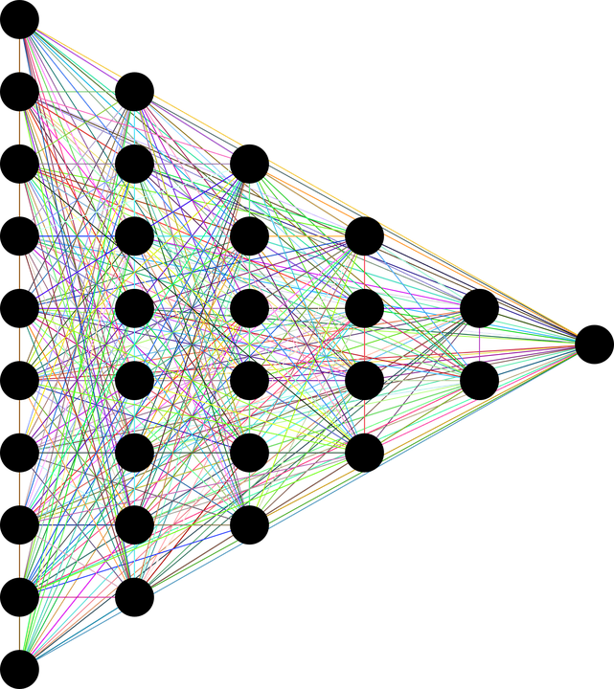
Deep Learning
Depth is a measure of how many hidden layers
3 or more layers (including input and output) qualifies as “deep” learning.
Fully Connected
Each neuron sends its output to every neuron in the next layer.
Feed Forward
Information flows from input through to output layer
There are no feedback loops
Feed Forward Fully Connected Artificial Neural Network (ANN)
There are many variations of ANN
INPUT
DATA
TARGET OUTPUTS
DEEP (HIDDEN LAYERS)

Slide 9

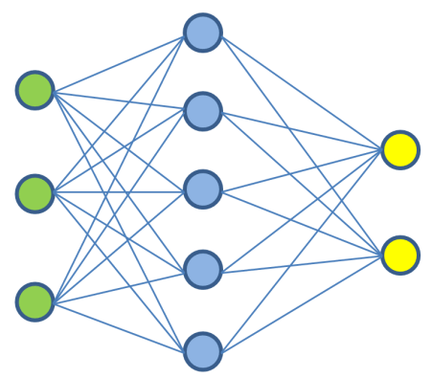

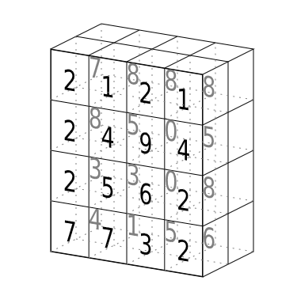


Deep Learning
People can understand these inputs
People can understand these outputs
Buy
Sell
Hold

Slide 10



Machine Learning vs Deep Learning
Deep learning can perform automatic feature extraction
Machine Learning cannot
Machine learning Process:
select the model to train,
manually perform feature extraction.
Deep Learning Process:
select the architecture of the network,
features are automatically extracted by feeding in the training data (such as images) along with the target class (label).
MACHINE LEARNING
DEEP LEARNING
Manual Feature
Extraction
Classification
Learned Features
Convolutional Neural Network
(CNN)
CAT
Machine
Learning
CAT
DOG
DOG
MOUSE
MOUSE

Slide 11
Categories of Machine Learning
Do people help the machines to learn ? How much help do people give the machines ?
Supervised
Unsupervised
Semi supervised**
Reinforcement
Can the machine learn incrementally on the fly ?
Online
Batch
Do they compare data to known data or detect patterns in data ?
Instance-based
Model-based
These may be combined in a variety of ways
An ML application might
Learn on the fly
Use a deep neural network
Trained using example data
This would make it online, model-based & supervised
Semi supervised**
Partially labelled data – some labelled, some not
Usually, combination of supervised and unsupervised algorithms

Slide 12
Types of Learning
SUPERVISED LEARNING
Training algorithms using labeled input/output data.
Classification
ARTIFICIAL INTELLIGENCE
Science that enables computers to mimic human intelligence. Subfields: Machine Learning, robotics, and computer vision
MACHINE LEARNING
Subset of AI that enable machines to improve at tasks with experience
Regression
UNSUPERVISED LEARNING
Training algorithms with no labeled data. It attempts at discovering hidden patterns on its own.
Clustering
Rule Association
REINFORCEMENT LEARNING
Algorithm take actions to maximize cumulative reward.
There are many many other types of unsupervised learning

Slide 13
Supervised Learning
Training data contains the answers - labeled
Classification
Predict the class of an observation
Is an email ham or spam
Is an image a dog or a cat
Is a transaction fraudulent or legitimate
Regression
Predict a target numeric value of an observation given a set of features
Price of a house - given location, square footage, number of bedrooms
Daily Temperature – given time of year, yesterdays temp
Percentage increase/decrease of a stock
Class – spam/ham
Target – numeric value being predicted
Features – square footage of house, location, yesterday's temperature
Predictors – a set of features, attributes used to predict a target
Attribute – a single feature, e.g., number of bedrooms
Usually, a feature is an attribute and its value

Slide 14
Supervised Learning
Some regression algorithms can be used for classification
Some classification algorithms can be used for regression
Common supervised learning algorithms include
k-Nearest Neighbours
Linear Regression
Logistic Regression
Support Vector Machines
Decision Trees and Random Forests
Neural Networks

Slide 15
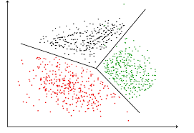
Unsupervised Learning
Training data does not contain the answers - unlabeled
Tier 1
Clustering
Detect groups of similar observations
K-Means
Hierarchical Cluster Analysis (HCA)
Expectation Maximization
e.g.
40% of customers are over 65 – Tier1
15% are at school – Tier 2
45% are working – Tier 3
Tier 2
Tier 3

Slide 16
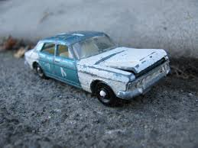
Unsupervised Learning
Dimensionality Reduction/ Feature Extraction
Principal Component Analysis (PCA)
Kernel PCA
Locally Linear Embedding (LLE)
T-distributed Stochastic Neighbour Embedding (t-SNE)
Used to output simplified data without loosing information
Merge several features into one
Correlation between cars age and mileage – wear and tear

Slide 17
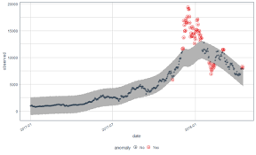
Unsupervised Learning
Anomaly / Outlier Detection
Principal Component Analysis (PCA)
Kernel PCA
Locally Linear Embedding (LLE)
T-distributed Stochastic Neighbour Embedding (t-SNE)
Credit card fraud
Manufacturing defects
Bad customer review

Slide 18
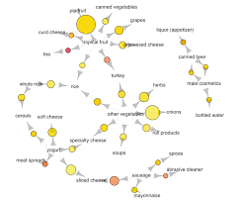
Unsupervised Learning
Association Rule Learning
Principal Component Analysis (PCA)
Kernel PCA
Locally Linear Embedding (LLE)
T-distributed Stochastic Neighbour Embedding (t-SNE)
Gain insights into data
Web site recommendations
Spell Checkers
Insurance quotes

Slide 19
Reinforcement Learning
Reinforcement learning allows machines take actions to maximize cumulative reward.
Reinforcement algorithms learn by trial and error through reward and penalty.
Two elements: environment and learning agent.
The environment rewards the agent for correct actions.
Based on the reward or penalty, agent improves its environment knowledge to make better decision.
Key Words
Trial
&
Error

Slide 20
Batch & Online Learning
Batch
Cannot learn incrementally
Trained offline and then launched
When new data becomes available, stop & retrain
Often computationally expensive
Online
System trained in mini-batches
Small and cheap learning steps
Good when data arrives in continuous streams (e.g. predicting stock prices)
Good when data cannot fit into machine (out of core learning)

Slide 21
Instance Based & Model Based Learning
ML systems need to be generalized
After training, how best to generalize to data it has never seen before
Instance-Based
Compare unlabeled instance vs labelled instance
Needs a measure of similarity – e.g. how many words in a document
System learns by heart then generalizes
Model Based
Build a model from training data
Use the model to make predictions

Slide 22



ML Example

Slide 23
Does Money make people happy?
OECD
Organisation for Economic Co-operation and Development (OECD) produce a measure of a country's happiness.
Factors in many variables – Life expectancy, level of education, air pollution etc
IMF
Produce GDP information for various countries.
Is it possible to combine both sets of data and determine if money makes people happy

Slide 24

Example – Money & Happiness
The data suggests an increase in satisfaction in line with a countries GDP
An eyeball seems to suggest this is a linear function
$life_satisfaction=b_{0}+b1 X GDP(per_capita$₎
Life Satisfaction
Country | GDP per capita | Life satisfaction
Hungary | 12,240 | 4.9
Korea | 27,195 | 5.8
France | 37,675 | 6.5
Australia | 50,962 | 7.3
United States | 55,805 | 7.2
Hungary
Korea
France
Australia
USA
GDP / Capita

Slide 25
Example – Money & Happiness
Same as straight line equation y = mx + c
Coefficient
A measure of how sensitive the dependent variable is to unit changes in the independent variable(s)
Dependent Variable
The thing we are trying to explain
Constant
Independent Variable
What causes the dependent variable to change
y = b₀ + b_{i} ⨉ x_{i}
Happiness
happiness = b₀ + b_{i} ⨉ experience
b₀ is constant,
the amount of happiness for having no money
GDP/Capita

Slide 26


Example – Money & Happiness
This model has 2 parameters, $b_{o}and b_{1}$
Its possible to change these parameters to represent any linear function
Life Satisfaction
What are the correct values for $b_{o}and b_{1}$?
Use either
a fitness function (how good is it)
a cost function (how bad is it)
GDP / Capita

Slide 27
Example – Money & Happiness
Life Satisfaction
Y_{i} – what the value actually is.
Y_{i}∧ – what the value should be
The model / predicted value.
Y_{i} - Y_{i}∧ _{= difference}
GDP / Capita
∑(Y_{i} - Y_{i}∧)²
Linear regression based on best fit line
Draw a line, measure the difference between actual and expected
Square the differences and sum.
The line with the smallest sum of squares is the best fit

Slide 28
Example – Money & Happiness
Give the model some data and it finds the values that best fit the data
AKA training the model
Now we can predict the happiness of Cyprus - a country with a GDP of 22,587
Life Satisfaction
b₀ – 4.85
b₁ = 4.91 X 10 ⁻⁵
GDP / Capita

Slide 29


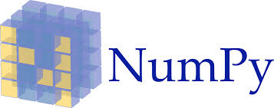

Example – Money & Happiness
A very popular ML library for python is Scikit-Learn
Free, works seamlessly with pandas and numpy
Supports many common ML models
Some knowledge of python and basic data science is required
Slicing, DataFrames, variables, string manipulation etc

Slide 30
Example – Money & Happiness
Import the python packages
Import the data
import pandas as pd
import sklearn.linear_model
df_happiness = pd.read_csv(filepath_or_buffer='../Data/life_satisfaction.csv’,
index_col='Country’)

Slide 31
Example – Money & Happiness
Everything but the last column
X = df_happiness.iloc[:, :-1].values
y = df_happiness.iloc[:, -1:].values
Naming Conventions
Uppercase X - a matrix
Lowercase y – a vector
All Rows
The Last Column
model = sklearn.linear_model.LinearRegression()
model.fit(X, y)

Slide 32
Example – Money & Happiness
Make a prediction
e.g. the happiness of Cyprus, given its GDP/Capita ($22,587)
A list of inputs
df_gdp = pd.read_csv(filepath_or_buffer = "../data/gdp.csv", index_col='Country')
gdp_cyprus = df_gdp.loc['Cyprus']
pred = model.predict([gdp_cyprus])
print(pred[0])
A list of outputs

Slide 33
Example – Money & Happiness
See Notebook 01A - Money_And_Happiness for examples
Complete Lab 1A - Money_And_Happiness

Slide 34


